Slide 1
DBMS Third Normal Form

Slide 2
Third Normal Form is an upgrade to Second Normal Form.
When a table is in the Second Normal Form and has no transitive dependency, then it is in the Third Normal Form.

Slide 3
Requirements for Third Normal Form
For a table to be in the third normal form,
It should be in the Second Normal form.
And it should not have Transitive Dependency.

Slide 4
Transitive dependency
Score table

Slide 5
Score table
score_id | student_id | subject_id | marks | exam_name | total_marks

Slide 6
student_id + subject_id. Primary key
For example, a mechanical engineering student will have Workshop exam but a computer science student won't. And for some subjects you have Practical exams and for some you don't. So we can say that exam_name is dependent on both student_id and subject_id.

Slide 7
Well, the column total_marks depends on exam_name as with exam type the total score changes.
For example, practicals are of less marks while theory exams are of more marks.
This is Transitive Dependency. When a non-prime attribute depends on other non-prime attributes rather than depending upon the prime attributes or primary key.

Slide 8
Score Table
score_id | student_id | subject_id | marks | exam_id

Slide 9
Exam table
exam_id | exam_name | total_marks
1 | Workshop | 200
2 | Mains | 70
3 | Practicals | 30

Slide 10
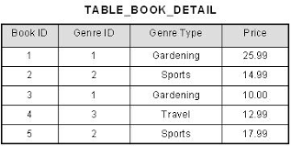
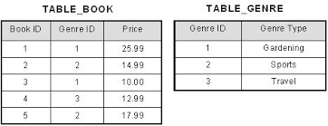
Here assume Book_Id and Genere ID are primary key.
Genre type is depend on Genre Id and book id.
Price depend on Genre type.
non prime key depends on non prime key.

Slide 11
EMP_ID | EMP_NAME | EMP_ZIP | EMP_STATE | EMP_CITY
222 | Harry | 201010 | UP | Noida
333 | Stephan | 02228 | US | Boston
444 | Lan | 60007 | US | Chicago
555 | Katharine | 06389 | UK | Norwich
666 | John | 462007 | MP | Bhopal
Emp_state is not primary key. Emp_city is depend on emp_state.
Non prime key is depend on non prime key.
EMP_ID | EMP_NAME | EMP_ZIP
222 | Harry | 201010
333 | Stephan | 02228
444 | Lan | 60007
555 | Katharine | 06389
666 | John | 462007

Slide 12
EMP_ZIP | EMP_STATE | EMP_CITY
201010 | UP | Noida
02228 | US | Boston
60007 | US | Chicago
06389 | UK | Norwich
462007 | MP | Bhopal

Slide 13
Advantage of removing Transitive Dependency
Amount of data duplication is reduced.
Data integrity achieved.

Slide 14
Thank you !

